Slide 1
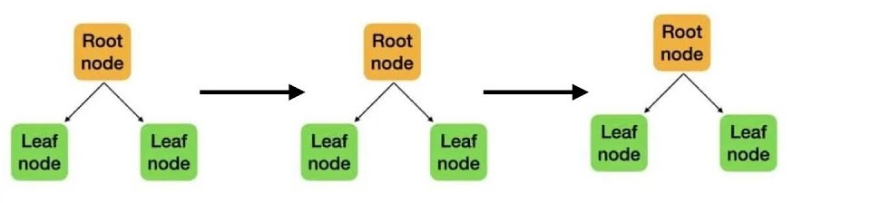
What is XGBoost? eXtreme Gradient Boosting

Slide 2
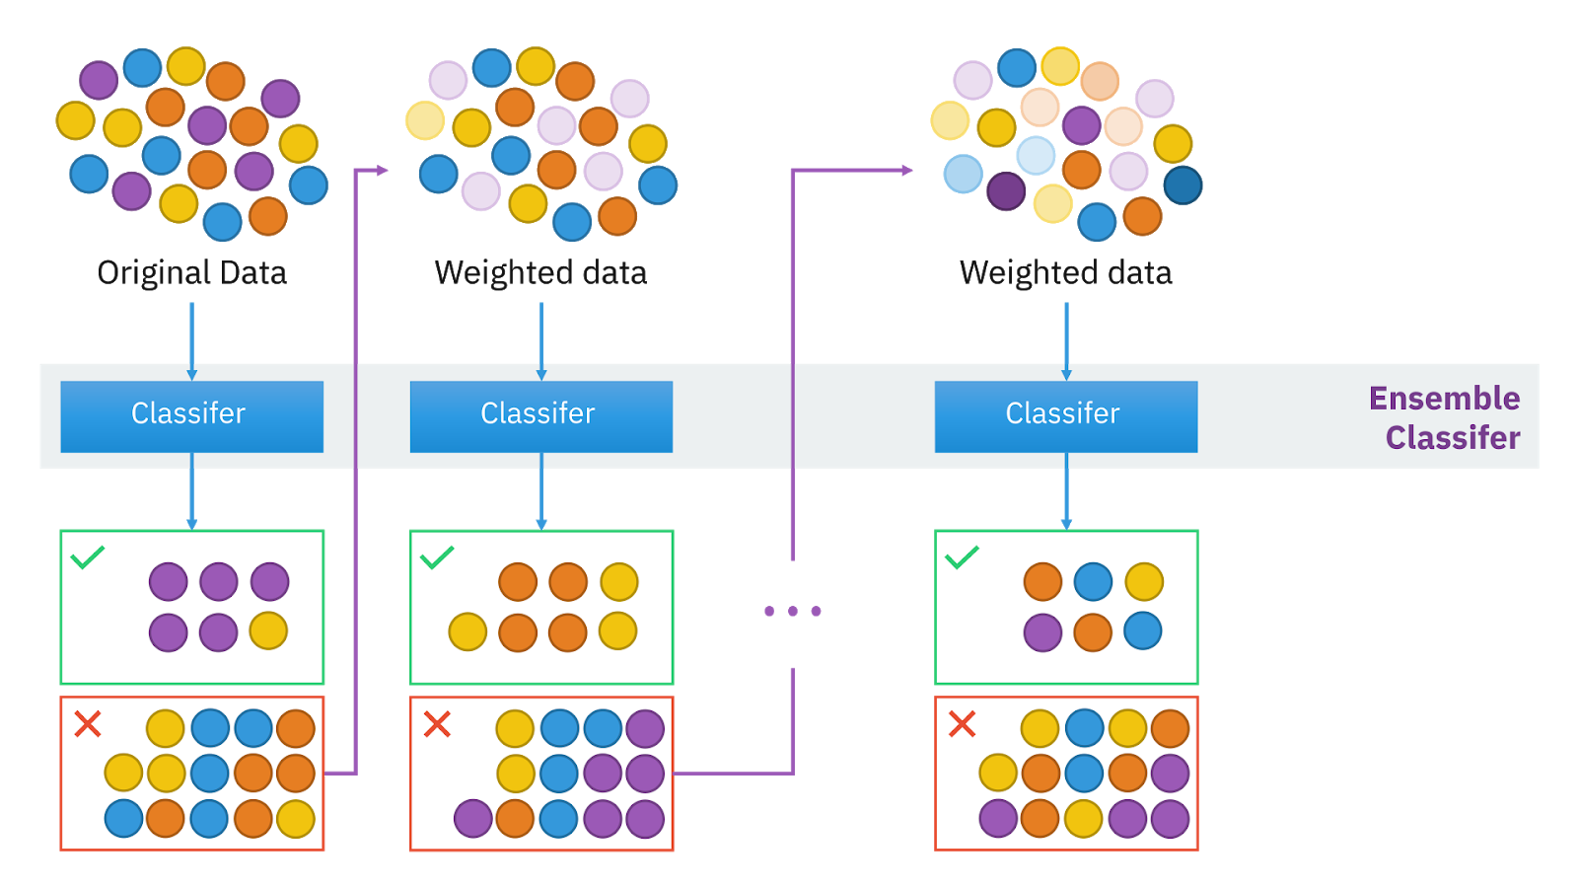
What is XGBoost?
XGBoost, short for eXtreme Gradient Boosting, is an open-source software library that provides an efficient and scalable implementation of gradient boosted decision trees. Designed for speed and performance, XGBoost is widely used in machine learning competitions and practical applications. It supports various objective functions, including regression, classification, and ranking tasks. Its known for its exceptional performance and scalability especially in structured or tabular data. The main purpose of XGBoost is to improve the performance and speed of gradient boosting models, which are used for both classification and regression tasks.

Slide 3

How XGBoost Works
Here’s a step-by-step explanation of the process:
Initialization - The process begins with an initial prediction, which is usually the mean of the target values for regression or the mode for classification.
Boosting Iterations:
  Compute Residuals : For each instance in the dataset, compute the difference (residual) between the actual target value and the current prediction.
  Fit a Weak Learner : Fit a weak learner (typically a decision tree) to the residuals. The goal of this learner is to predict the residuals of the previous model.
  Update Model : Add the predictions of the weak learner to the overall model. This updates the current predictions to reduce the residuals.
  Shrinkage : Apply a learning rate to shrink the contribution of each weak learner, which helps prevent overfitting.

Slide 4
How XGBoost Works
3.Regularization:
  XGBoost includes several regularization techniques to improve generalization and reduce overfitting:
    L1 (Lasso) Regularization : Encourages sparsity in the model, which can lead to simpler models.
    L2 (Ridge) Regularization : Helps distribute the weights more evenly and prevents them from becoming too large.
    Tree Pruning : Prunes trees to prevent overfitting by limiting the maximum depth or using a minimum loss reduction threshold for a split to be added.
4.Handling Missing Values : XGBoost can handle missing values internally by learning the best imputation strategy based on the training data.
5.Parallel and Distributed Computing : XGBoost leverages parallel processing and can be distributed across multiple machines to handle large datasets efficiently.
6.Optimizations : Various optimizations like cache awareness, out-of-core computing, and optimized data structures are used to enhance performance.

Slide 5
Why XGBoost?
Efficiency: XGBoost is known for its computational speed, making it faster than other implementations of gradient boosting.
Scalability: It scales seamlessly across multiple CPUs and even GPUs, making it suitable for large datasets.
Performance: XGBoost often outperforms other algorithms, especially in scenarios where structured data is involved.
Flexibility: It supports various loss functions and customization, making it versatile for a wide range of applications.
Regularization: XGBoost includes L1 and L2 regularization, which helps prevent overfitting and improves model generalization.

Slide 6
When to Use XGBoost
1. Structured or Tabular Data: XGBoost performs exceptionally well on structured or tabular data. This includes datasets where the features are in table format, like CSV files or SQL database extracts.
2. Large Datasets: XGBoost can handle large amounts of data efficiently, thanks to its scalability and parallel processing capabilities.
3. High-Dimensional Spaces: XGBoost can deal with a high number of features without the need for feature reduction, making it ideal for scenarios where all features carry significant information.
4. Classification and Regression Tasks: XGBoost works well for both classification (binary and multi-class) and regression tasks, making it versatile for various types of predictive modeling.
5. Competitive Machine Learning: Given its performance, XGBoost is often used in machine learning competitions, such as those on Kaggle, where the goal is to achieve the highest possible model accuracy.

Slide 7
When Not to Use XGBoost
1. Image, Text, or Audio Data: For unstructured data, such as images, text, or audio, neural networks often outperform XGBoost. These data types require models that can capture complex patterns and sequential dependencies, which are better handled by deep learning techniques.
2. Real-Time Predictions: While XGBoost is fast, it might not be the best choice for applications requiring real-time responses, especially when the dataset is very large.
3. Small Datasets: On smaller datasets, the power of XGBoost might not be fully realized, and simpler models could perform just as well, if not better. Moreover, XGBoost might overfit if the dataset is too small.
4. Interpretability is a Priority: If the primary requirement is to have a highly interpretable model, simpler models like logistic regression or decision trees might be more suitable. XGBoost, being an ensemble of decision trees, can be more challenging to interpret.
5. Limited Computational Resources: XGBoost can be computationally intensive, especially when tuning hyperparameters. If computational resources are limited, simpler models or less resource-intensive algorithms might be more practical.

Slide 8
Languages and Interfaces
Great feature of XGBoost is its versatility and can be used in many programming languages and interfaces, including:
Python - Via the xgboost package.
R - Through the xgboost library.
Java - With the XGBoost4J module.
Scala - Using the XGBoost4J-Spark package.
Julia - Via the XGBoost.jl package.
C++ - Directly using the core library.
CLI (Command Line Interface) - For integration with other systems.
In the next slides, we will check the comparison chart of different tools

Slide 9
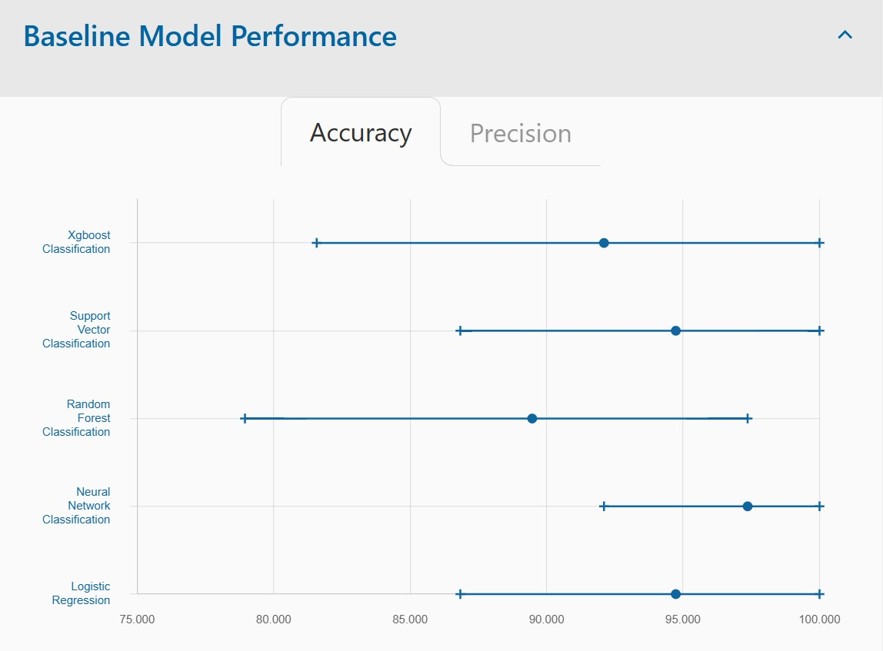
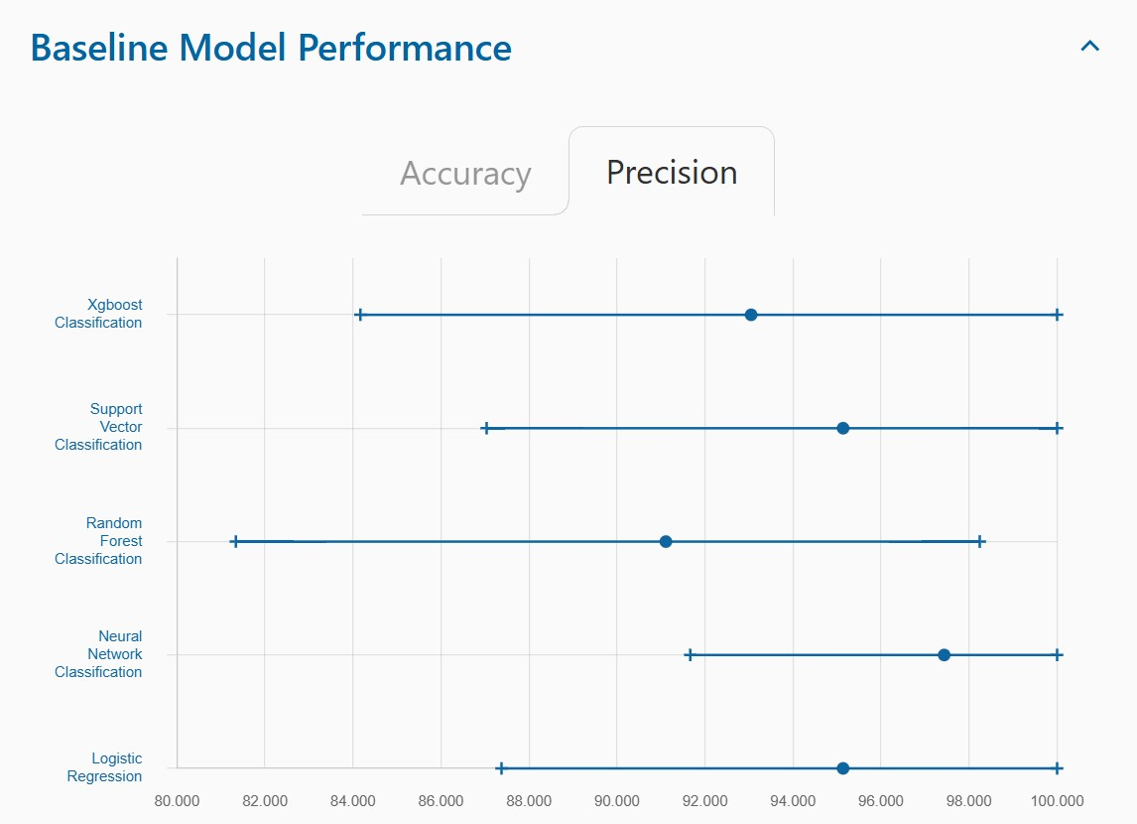
Iris: Biology

Slide 10
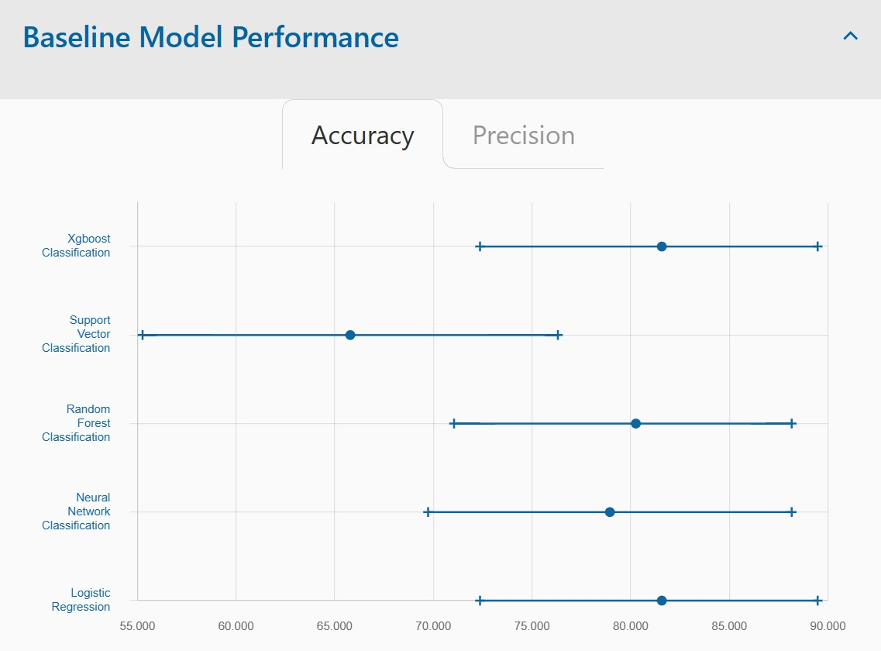
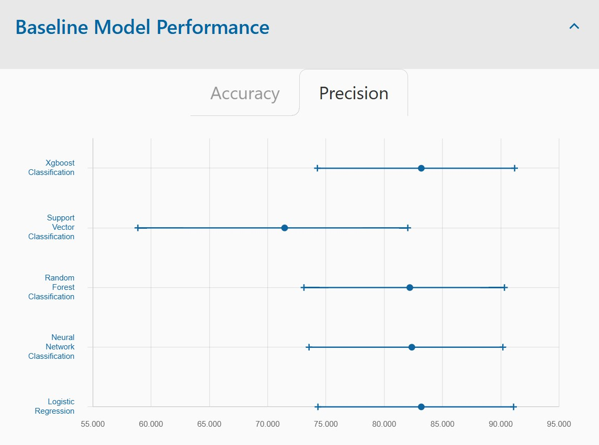
Heart Disease: Health and Medicine

Slide 11
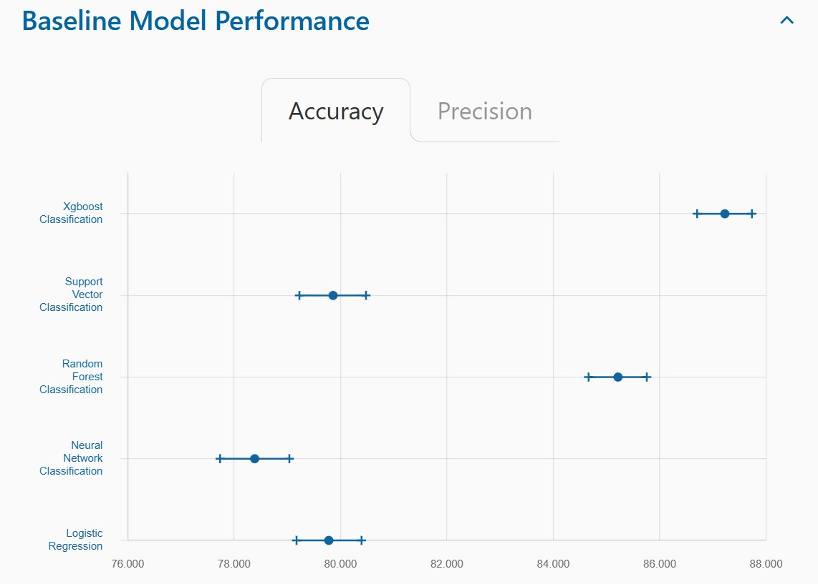
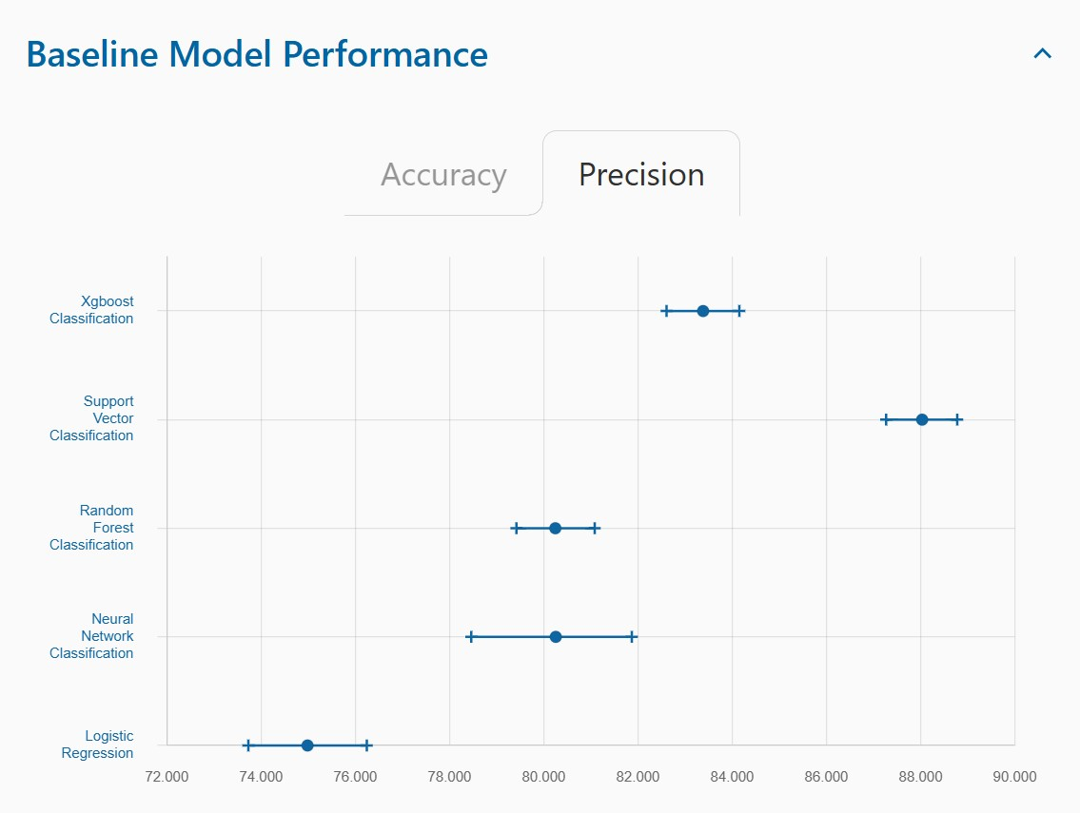
Adult: Social Science

